Slide 1
NUOVE FRONTIERE NELLA SINERGIA TRA TERAPIA MEDICA E TERAPIA CHIRURGICA
LUCA BUSETTO
UNIVERSITA’ DI PADOVA

Slide 2

LUCA BUSETTO - Disclosures
- Advisory Board Member: Novonordisk
Eli Lilly
Pzifer
Boehringer Ingelheim
Bruno Farmaceutici
- Invited Speaker: Rythm Pharmaceuticals
  Pronokal

Slide 3
ROLE OF OBESITY MANAGEMENT MEDICATION (OMM)
FOR PATIENTS UNDEROGOING METABOLIC/BARIATRIC SURGERY
Preparation to surgery: pre-op weight loss
Management of weight regain and insufficient weight loss after surgery
Integrated medical-surgical management

Slide 4
ROLE OF OBESITY MANAGEMENT MEDICATION (OMM)
FOR PATIENTS UNDEROGOING METABOLIC/BARIATRIC SURGERY
Preparation to surgery: pre-op weight loss
Management of weight regain and insufficient weight loss after surgery
Integrated medical-surgical management

Slide 5
Kushner BS & Eagon JC. Obes Surg. 2021;31:5936

Slide 6

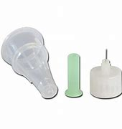

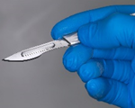
6-8
1
TIME TO SURGERY (months)

Slide 7
ROLE OF OBESITY MANAGEMENT MEDICATION (OMM)
FOR PATIENTS UNDEROGOING METABOLIC/BARIATRIC SURGERY
Preparation to surgery: pre-op weight loss
Management of weight regain and insufficient weight loss after surgery
Integrated medical-surgical management

Slide 8
Peterli R et al. JAMA 2018;319:255

Slide 9
Wharton S et al. Clin Obes 2019;9:e12323

Slide 10
Lautenbach A et al. Obes Surg 2022;32:3280

Slide 11
Murvelashvili N et al. Obesity 2023;31:1280

Slide 12

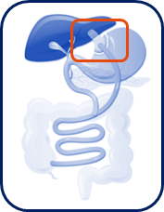


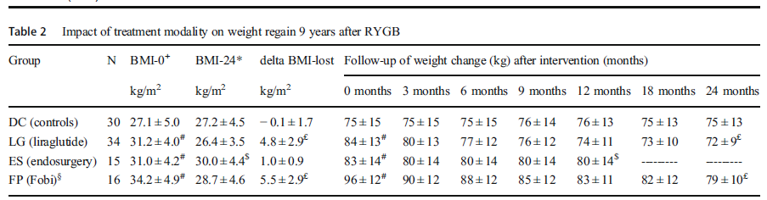
24 Months
Loss of regained weight from NADIR
< 10% weight regain from NADIR
lifestyle counselling
(n = 30)
+6%
Apollo’s Overstitch System (n = 15)
-20%
95 patients underwent RYBG
≥ 10% weight regain from NADIR
Surgical revision
9±4 years post surgery
Fobi-ring
(n = 16)
-87%
Pharmacotherapy
Liraglutide 3.0 mg (n = 34)
-85%*
37% of Fobi-ring patients experienced serious complications vs other groups (p < 0.05)
lead to hospitalization in 2 cases
endoscopic dilatation of the upper anastomosis (up to 32 times) due to an inability to eat and vomiting
Horber FF et al. Obes Surg 2021;31:93

Slide 13
RYGB or LSG patients with persistent or recurrent type 2 diabetes
at least 1 year after surgery from five hospitals in London, UK.
Miras AD et al. Lancet Diabetes Endocrinol 2019;7:549

Slide 14
Inclusion criteria:
Poor weight loss after MS (RYGB or LSG)
≤ 20% body weight loss at least 1 year after MS
Suboptimal nutrient-stimulated GLP-1 response
≤ 2-fold increase in circulation GLP-1 between 0 and 30
min following a standardised 500 kcal mixed liquid meal
Mok J et al. JAMA Surg 2023;158:1003

Slide 15
Mok J et al. JAMA Surg 2023;158:1003

Slide 16
ROLE OF OBESITY MANAGEMENT MEDICATION (OMM)
FOR PATIENTS UNDEROGOING METABOLIC/BARIATRIC SURGERY
Preparation to surgery: pre-op weight loss
Management of weight regain and insufficient weight loss after surgery
Integrated medical-surgical management

Slide 17
Badurdeen D et al. Gastrointest Endosc 2021;93:1316

Slide 18
Takur U et al. Obes Surg 2021;31:84

Slide 19

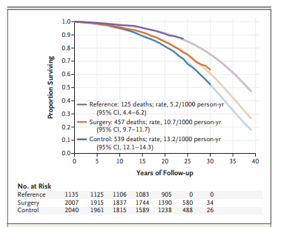
Carlsson LMS et al N Engl J Med 2020;383:1535

Slide 20

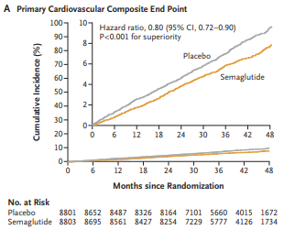
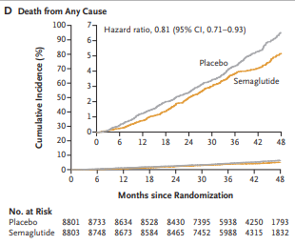
Lincoff AM et al N Engl J Med 2023;389:2221

Slide 21
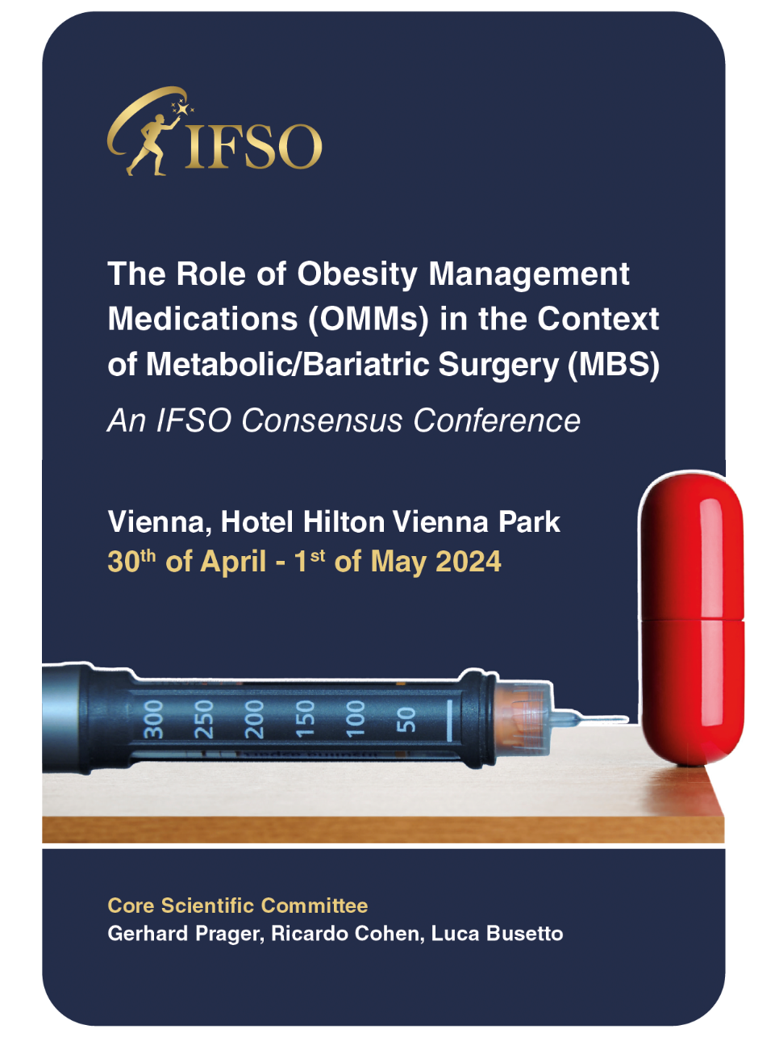
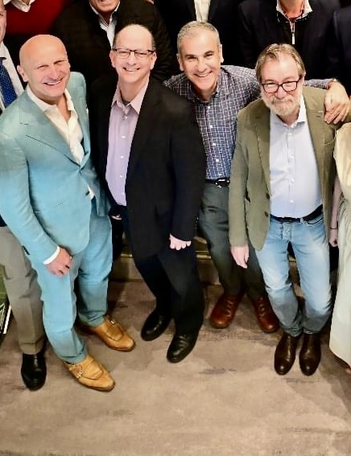
Gerhard Prager
Randy Levinson (Delphi Expert)
Ricardo Cohen
Luca Busetto

Slide 22





Grazie
luca.busetto@unipd.it
Luca Busetto
@busetto_luca

